Slide 1

Cocktail juice

Slide 2
Team
1- team leader :reem Mohsen AHMED
Id:2101491
2- member1:Bassant Mohamed hashem
Id:210188
3- member2:Omnya Mamdouh mohamed
Id:2101433
4-Member4:poula essam fatthy
Id:2101446
5-member5:Ali regab ali
Id:2100462
6-member6:Mohamed kamel
Id:2101218

Slide 3


Introduction
Throughout history, cocktail juice has been revered for its ability to elevate the drinking experience, whether enjoyed in the bustling streets of cosmopolitan cities or the serene landscapes of tropical paradises. It transcends cultural boundaries, uniting people in their appreciation for the simple pleasures of life.

Slide 4



Agenda
Chart of date set
Table of date set
introduction
Name and id of team
Content
summery

Slide 5

Topic one
the library that using it to help to make a date set
1-numpy
2- pandas
3- seaborn
4-statsmodels

Slide 6
Timeline
pre processing the date processing and feature enginering
Show the third two models support vector machine and random forest
Show the first two models logistic and naïve
Show the second two models k-nearest neighbors and descion tree
Take the best 3 models that give high accuracy

Slide 7
Outlier
An outlier is a data point that significantly differs from other observations in a dataset. It's an observation that lies an abnormal distance from other values in a sample. Outliers can occur due to various reasons such as measurement error, experimental error, or genuine deviation from the rest of the data due to some unique property or circumstance. Identifying outliers is essential in statistical analysis as they can skew results and affect the interpretation of data.

Slide 8
Missing value
missing values is an essential aspect of data cleaning and analysis, as they can affect the accuracy and reliability of statistical analyses and machine learning models. Various techniques, such as imputation or deletion, can be used to handle missing values depending on the context and the goals
analyze

Slide 9
Encoding and decoding
Encoding: Encoding refers to the process of converting data from one format or representation into another format. This transformation is typically done to facilitate storage, transmission, or processing of data. In the context of computing, encoding often involves converting human-readable data (such as text or images) into a format that can be efficiently processed by machines or transmitted over communication channels. Examples of encoding methods include ASCII, UTF-8, Base64 for text data, and JPEG, PNG for image data.
Decoding: Decoding is the reverse process of encoding. It involves converting encoded data back into its original format or representation. Decoding is necessary to interpret and use data that has been previously encoded. For example, when receiving a message encoded in a particular format, a decoding process is required to convert it back into its original form so that it can be understood or processed by humans or machines.
In summary, encoding transforms data into a different format, while decoding reverses this process to recover the original data. These processes are fundamental in various applications where data needs to be stored, transmitted, or processed efficiently and reliably.

Slide 10
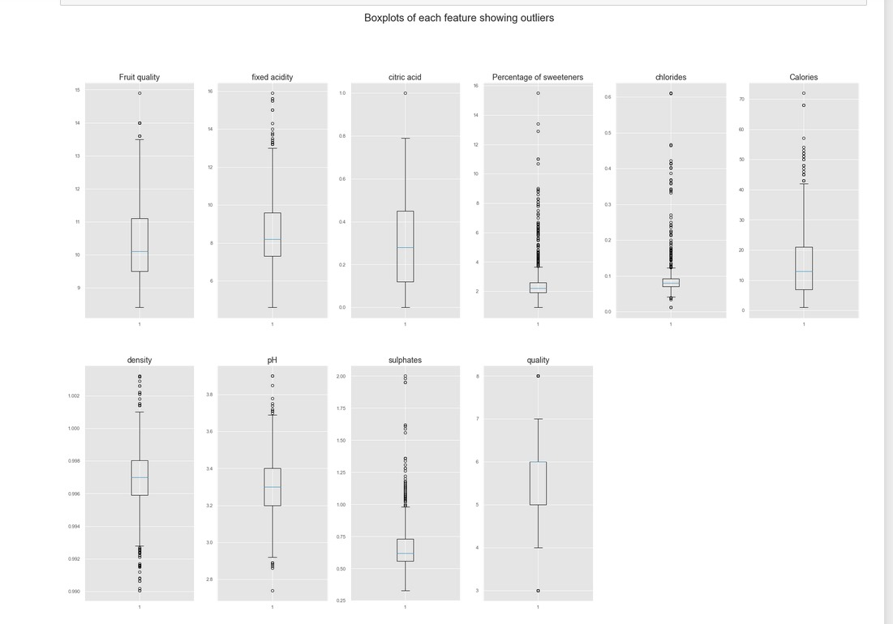

The way to get started is to quit talking and begin doing.
Walt Disney

Slide 11
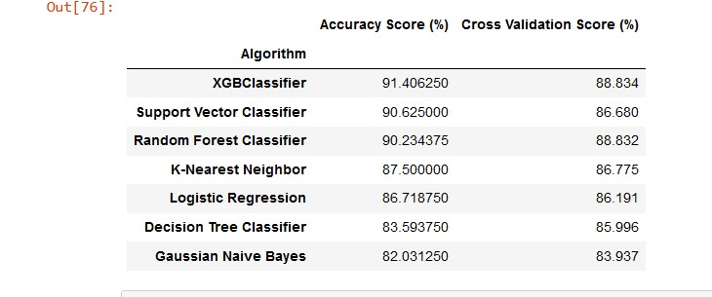

Slide 12
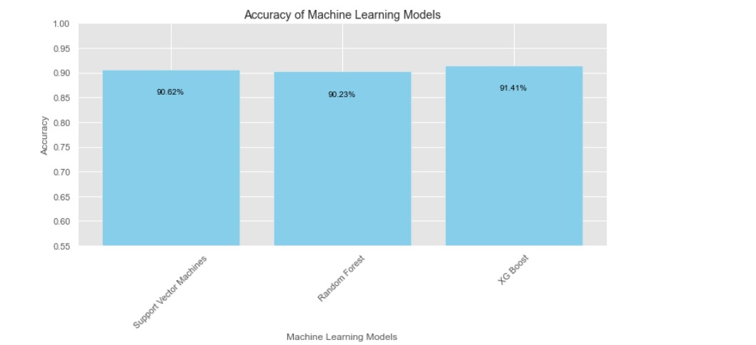

Slide 13
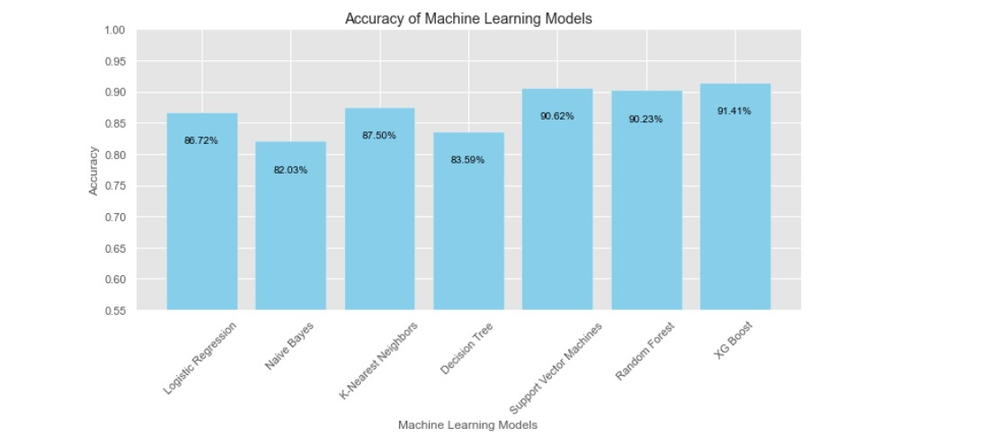

Slide 14
Content
Subtitle
Subtitle
Accuracy scores for each model.
Plotting the accuracy scores.
predict based on the input features.
Train and test the model

Slide 15
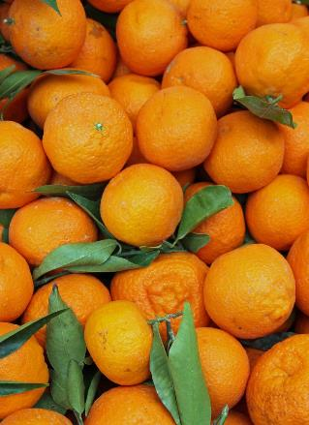



Summary
Take the date then training and testing it by using the models then take the three models that give the best accuracy
, %80 of the work is data preprocessing, and %20 of the work is modeling in a machine learning

Slide 16



Thank you

